Slide 1
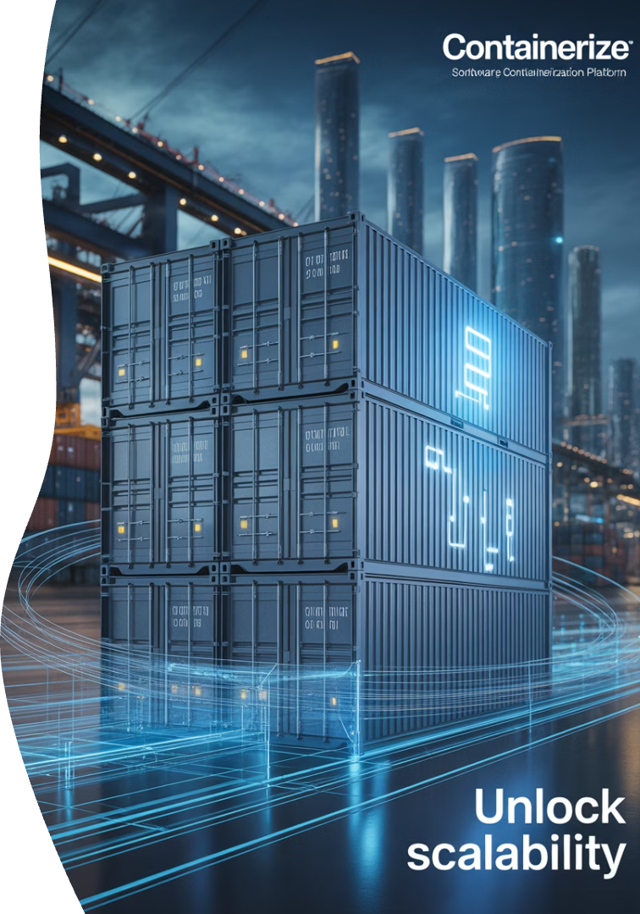
Containers
Lightweight, Portable, and Scalable App Deployment
Software deployment revolutionized since 2013.
87% of enterprises use containers in production.
Docker containers run 12 billion times per month.
Consistent environments from laptop to cloud.

Slide 2

What Are Containers?
1
Definition
Containers are standardized units of software. They package code and dependencies together.
2
Architecture
Unlike virtual machines, containers share the host OS kernel. They run as isolated processes.
3
Efficiency
Containers use namespace isolation and resource limits. Their footprint is much smaller than VMs.

Slide 3
Containers Before and After
Before Containers
After Containers
Applications faced the "works on my machine" problem.
Consistent environments across all stages.
Environment inconsistencies between systems
Package everything needed in one unit
Complex dependency management
Isolated from host system
Long setup times for new developers
Same behavior everywhere
Unpredictable deployment behavior
Fast, reliable deployments

Slide 4
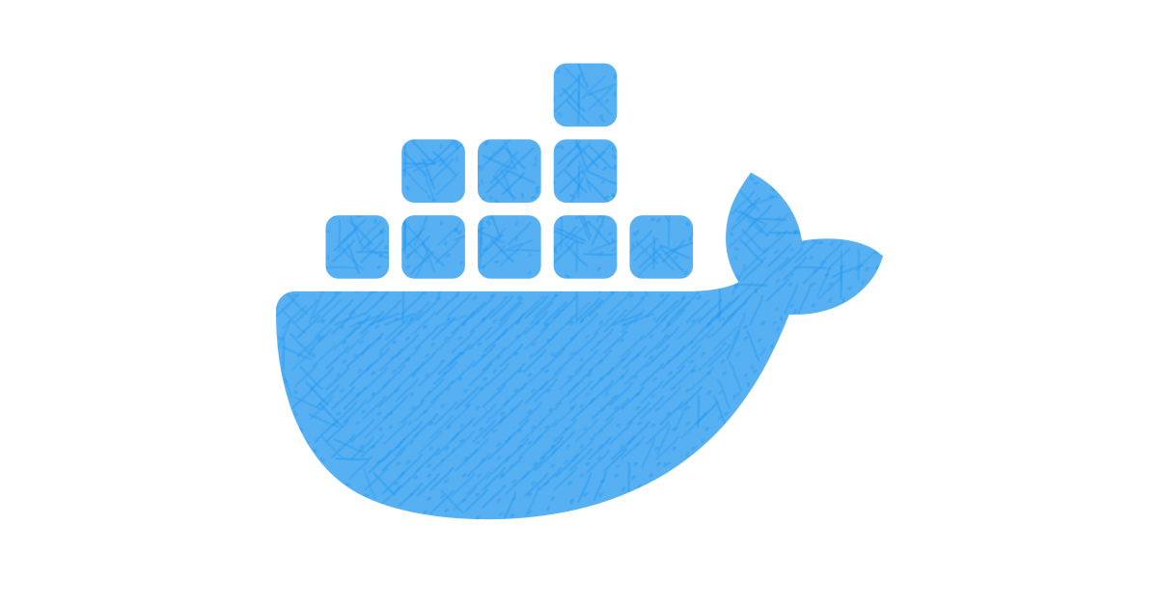





Key Docker Concepts
Images
Read-only templates with OS, code, and dependencies.
Containers
Running instances of images with isolated processes.
Dockerfile
Blueprint text file for building custom images.
Volumes
Persistent data storage outside the container lifecycle.
Ports
Communication channels between containers and host.

Slide 5
Volumes Example
Dockerfile
Build & Run
# Create a BusyBox container that writes the date to a file every 5 seconds
docker run -d -v logs:/data busybox sh -c \
"while true; do echo $(date) >> /data/log.txt; sleep 5; done"
# Check that the content was saved
docker run --rm -v logs:/data busybox cat /data/log.txt
Port Example
flsk_app.py
Dockerfile
Build & Run
from flask import
Flaskapp = Flask(__name__)
@app.route("/")
def hello():
return "Hello from Flask inside Docker!"
if __name__ == "__main__":
app.run(host="0.0.0.0", port=5000)
FROM python:3.10-slim
WORKDIR /app
COPY app.py .
RUN pip install flask
EXPOSE 5000CMD ["python", "app.py"]
docker build -t flask-demo .
docker run -p 8080:5000 flask-demo

Slide 6

Advantages and Disadvantages
Advantages
Disadvantages
Full portability across all environments
Less isolation than virtual machines
Sub-second startup times
Potential kernel-level security vulnerabilities
Highly resource-efficient operation
Steeper learning curve for teams
Perfect fit for microservices architecture
More complex debugging workflows

Slide 7
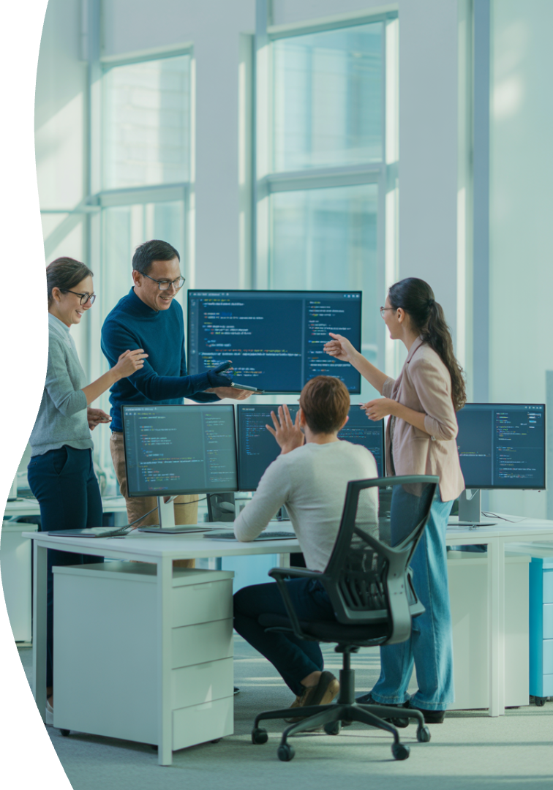




Why Use Docker?
Consistency
"Works on my machine" problem eliminated.
Speed
Deployment in seconds instead of minutes.
Efficiency
Run 4-10x more applications per server.
CI/CD
Simplified development pipelines.

Slide 8






Docker in the Real World
Local Development:
CI/CD Pipeline:
Spin up a PostgreSQL or MongoDB instance in seconds without installation hassles
Run automated tests in clean, consistent environments for each build
Cloud Deployment:
Sandbox Environments:
Seamlessly transfer applications between Kubernetes, ECS, or Docker Compose
Execute untrusted code safely with resource limits and isolation
Full-Stack Development:
Connect React frontend, Node.js API, and MySQL database containers with a single command

Slide 9
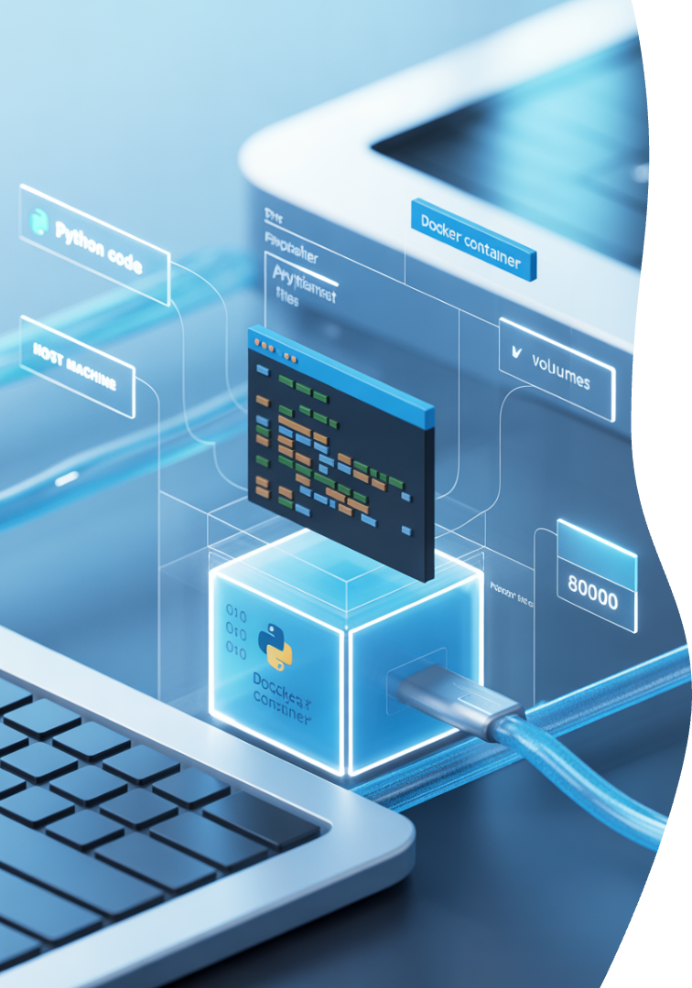
Python App Container Example
app.py
print("Hello from Docker!")
Dockerfile
Build & Run
FROM python:3.10-slim
COPY app.py .
CMD ["python", "app.py"]
docker build -t hello-python .
docker run hello-python

Slide 10
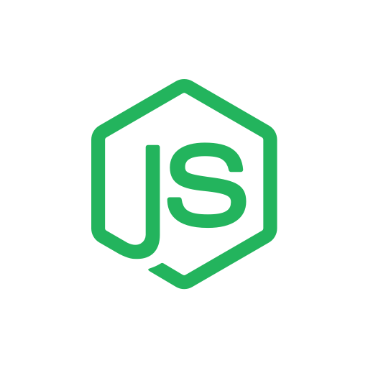
Node.js App Container Example
server.js
Dockerfile
Build & Run
const http = require('http’);
http.createServer((req, res) => {
res.end('Hello from Node.js in Docker!’);
}).listen(3000);
FROM node:18
COPY server.js .
CMD ["node", "server.js"]
EXPOSE 3000
docker build -t hello-node .
docker run -p 3000:3000 hello-node

Slide 11
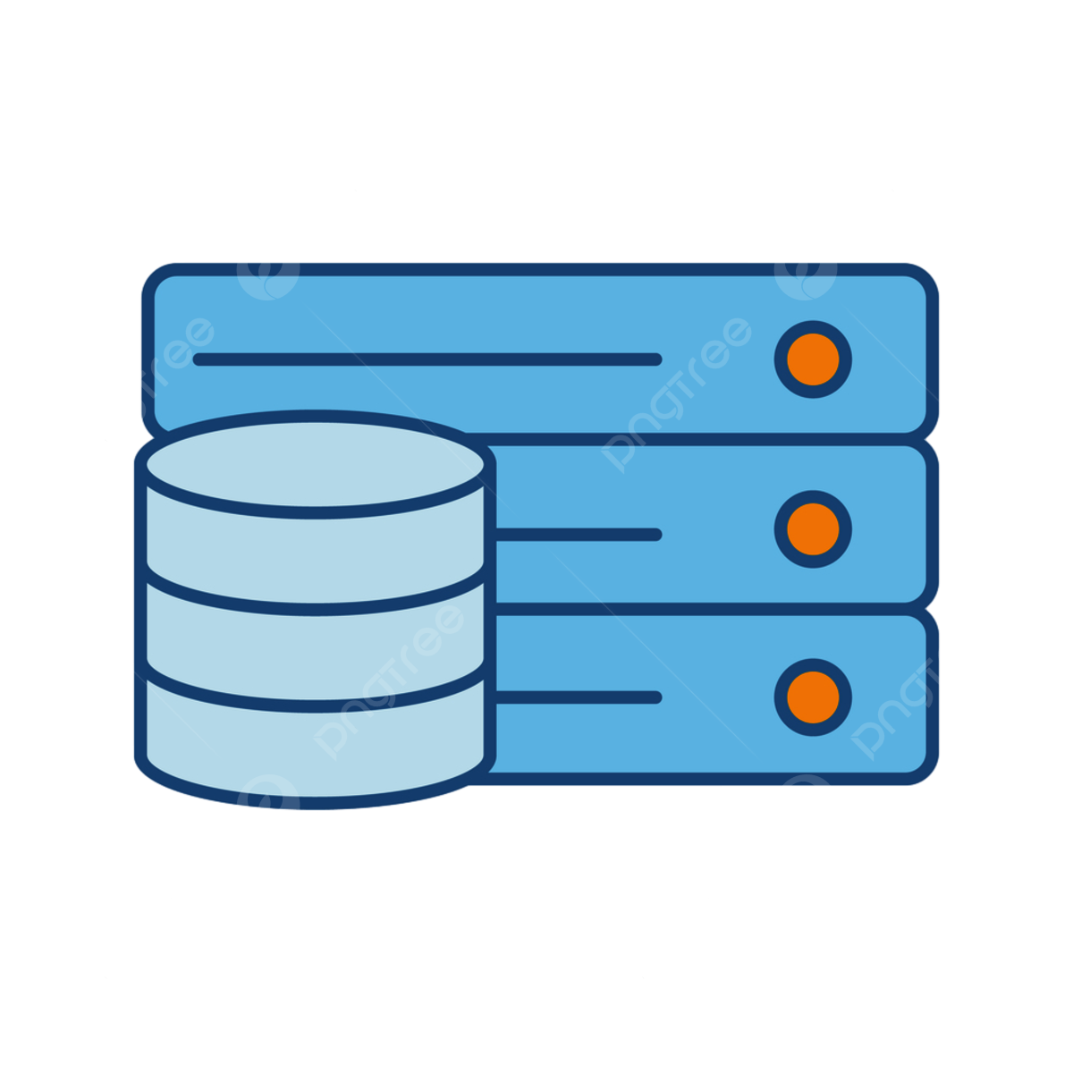
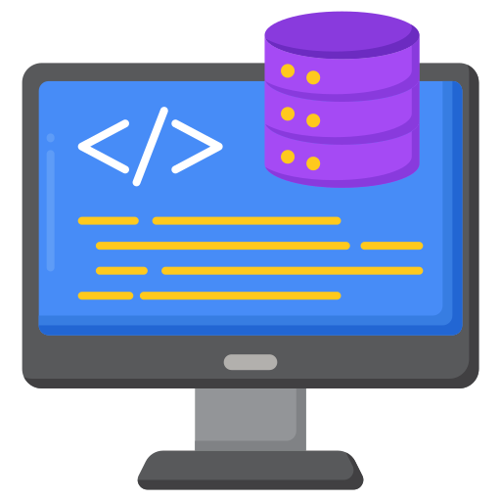
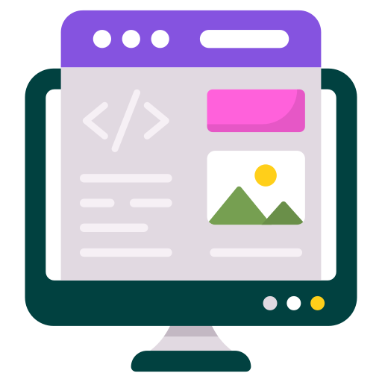
Multi Container Application
Backend
Database
Frontend
Problem!
How we need to run all those containers?

Slide 12
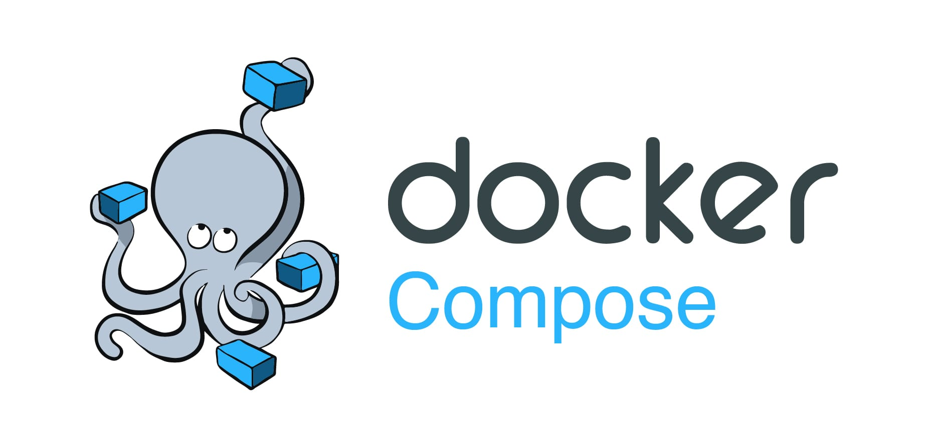
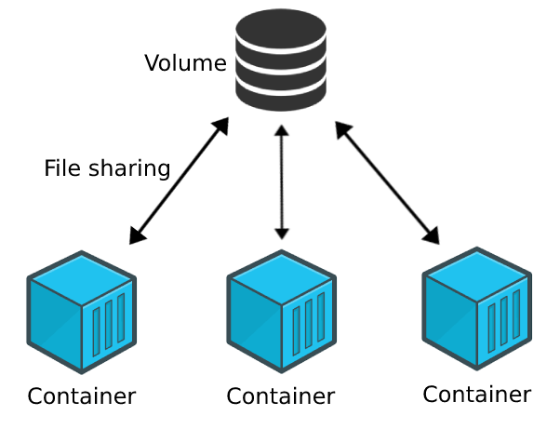
Define and run multi-container Docker applications using a YAML file.
Group services like web, API, and database into a single command: docker-compose up
Handles networking, dependencies, volumes, and environment variables.
Using volumes to connect all the containers.
Example: YAML
version: '3.8’
services:
backend: build: .
ports:
- "5000:5000"
depends_on:
- db
db:
image: postgres: latests
environment:
POSTGRES_PASSWORD: example
volumes:
- postgres_data:/exm/postgresql/data
volumes:
postgres_data

Slide 13
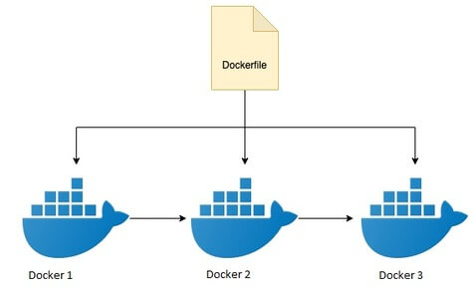
Multi-Stage Builds – Build Efficiently, Run Lean
Problem
Solution
When building apps that require compilation (Node, Java, Go...),
your code includes temporary files, heavy tools, and build artifacts.
Multi-stage builds allow you to compile code in one stage with all tools,
then copy only the final output into a small, clean runtime container.
Use multiple FROM statements to separate build and run environments
Final image is smaller, faster, and more secure
Why?
Keep build tools out of production
Reduce image size and attack surface

Slide 14
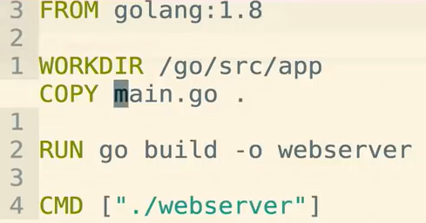
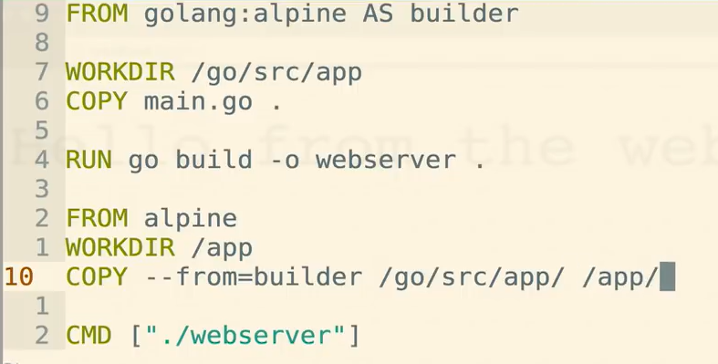
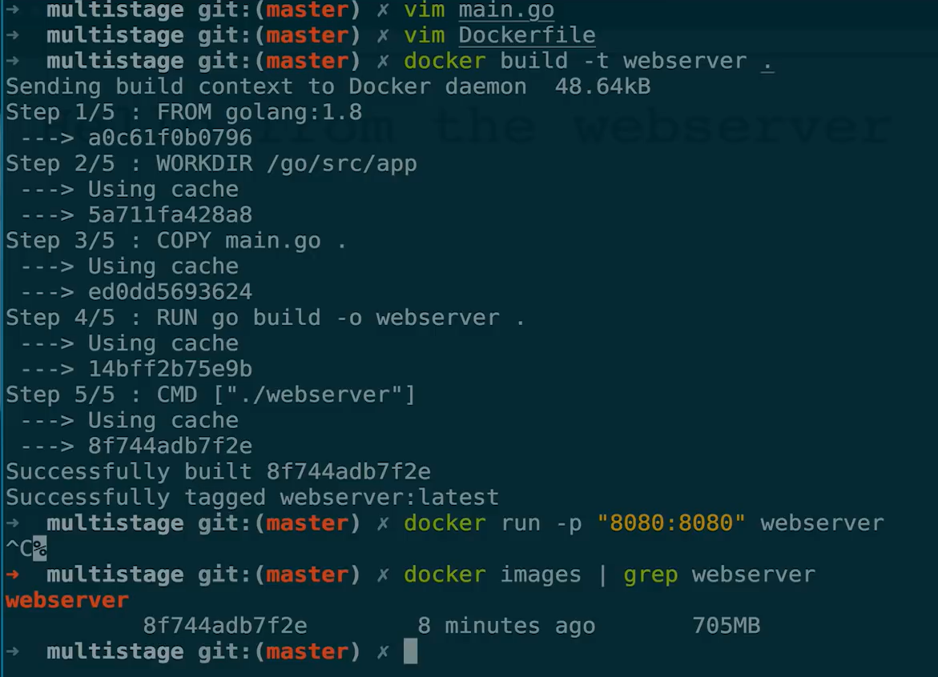
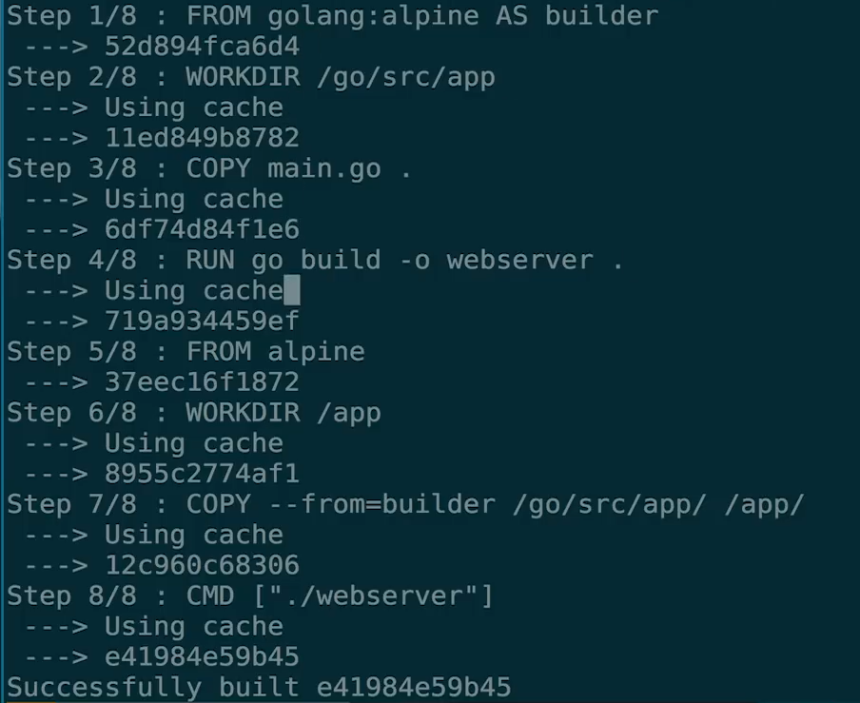
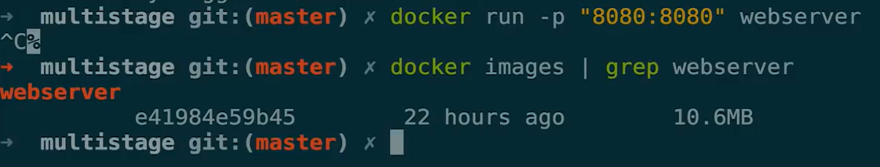
Multi-Stage Builds – Build Efficiently, Run Lean
Container
Container
Container

Slide 15
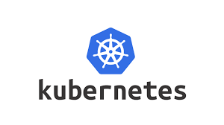
Kubernetes – Advanced Container Orchestration
Automates deployment, scaling, and management of containerized apps
Designed for production environments with high availability and resilience
Core Components:
Pod – Smallest deployable unit
Deployment – Defines scaling and versioning
Service – Exposes your app
Ingress – Manages HTTP routing
Use Cases:
Cloud-native apps
Scalable microservices
Production-grade workloads

Slide 16
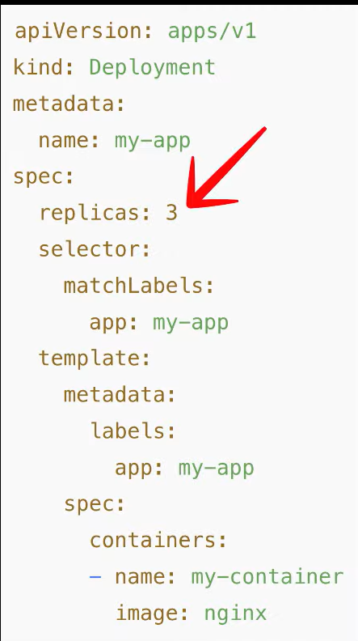
Kubernetes – Replicas
What Are Replicas in Kubernetes?
A replica is an instance (copy) of a Pod – a running container with the same application code.
The main purposes are:
Scaling – Handle more traffic by distributing load across multiple copies
Redundancy – If one Pod fails, Kubernetes replaces it automatically
Load Balancing – A Service automatically distributes traffic among replicas
Benefits:
High availability
Automatic recovery
Adaptability to changing traffic
identical
Pods

Slide 17

Current and Future Improvements
Serverless Containers
Security Enhancements
Smart Orchestration
(AI-Driven)
Run containers without managing servers. Automatically scale down to zero when idle.
Isolated runtimes, digital signatures for images, and kernel-level security
Using AI to optimize scaling, detect failures, predict resource usage, and manage rollouts with zero downtime.
Standardization & Interoperability
Containers on the Edge
Initiatives like OCI (Open Container Initiative) aim to ensure containers run the same across platforms – cloud, on-premises, or edge.
Running lightweight containers on edge devices (IoT, remote sensors, cameras) for real-time local processing.

